Slide 1
EVALUATION OF MACHINE LEARNING MODELS
MODULE 4:
Month DD, 20YY

Slide 2
Lessons:
Lesson-1
Lesson-2
Lesson-3
Evaluation of
Classification Algorithms
Evaluation of
Regression Algorithms
Evaluation of
Clustering Algorithms
Confusion Matrix
Accuracy
Precision
Recall
F1 Score
Area Under ROC Curve
MSE
RMSE
MAE
Coefficient of Determination
Silhouette Score
Rand Index
Adjusted Rand Index
Davies-Bouldin Index

Slide 3
Lesson-1 Evaluation of Classification Algorithms

Slide 4
WHY PERFORMATION EVALUATION OF ML MODEL
The performance evaluation can provide following insights about the model
How well the model is performing?
Will the model performance be adequate for the business requirement?
Is the features selected for are relevant for the problem?
Do we need to add more features to improve the performance of the model?
Can more training improve the performance further?

Slide 5

Evaluation OF CLASSIFICATION MODEL
For the machine learning problem the model need to be evaluated based on its outputs.
For classification problems the output of the model comes under,
True Positive
True Negative
False Positive
False Negative

Slide 6
CONFUSION MATRIX
The confusion matrix depicts actual positive, true negative, false positive, false negative values graphically.
Predictions
Positive
Negative
Actual Labels
Positive
True Positive | False Negative
False Positive | True Negative
Negative

Slide 7
CONFUSION MATRIX
In this example TP value is 750, TN is 1025, FP is 38, and FN is 27.
Predictions
Positive
Negative
Actual Labels
Positive
750 | 27
38 | 1025
Negative

Slide 8

ACCURACY
Accuracy is defined as the ratio of accurate prediction.
It is suitable when classes are well balanced.
$$Accuracy = \frac{Correct Prediction}{All Predictions}$$
$$Accuracy= \frac{TP+TN}{TP+FP+TN+FN}$$

Slide 9

ACCURACY
In the example shown above the accuracy value will be
$$accuracy = \frac{750+1025}{750+38+1025+27}= \frac{1775}{1840}= 0.9647=96.47\%$$

Slide 10
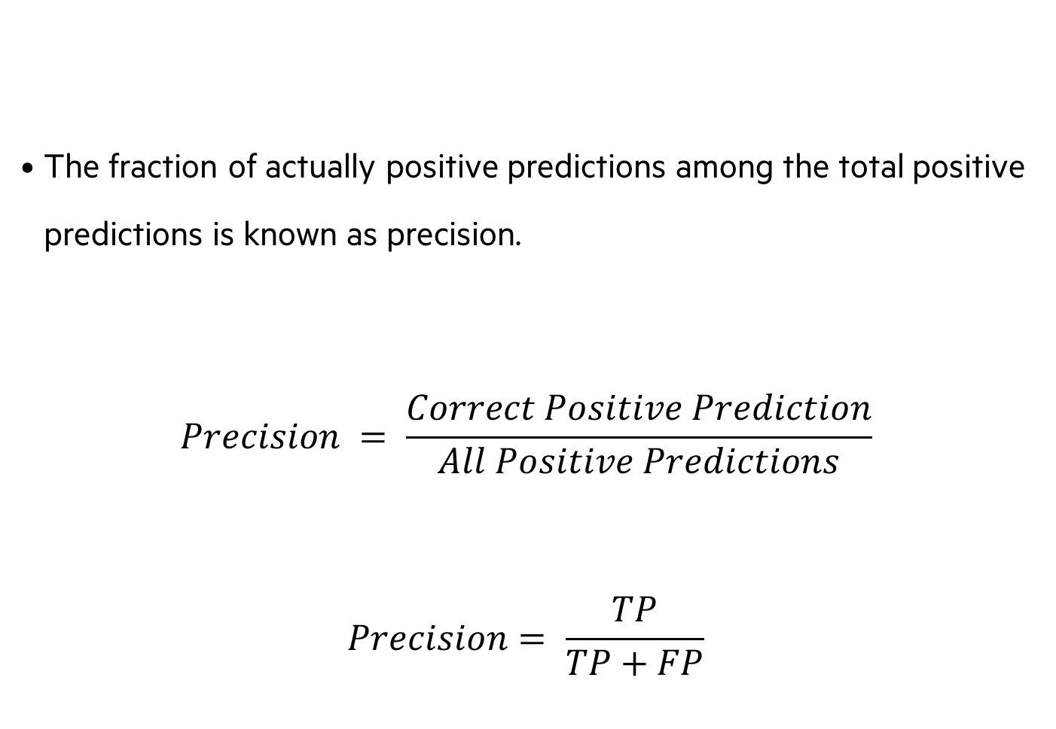
PRECISION
The fraction of actually positive predictions among the total positive predictions is known as precision.
$$Precision = \frac{Correct Positive Prediction}{All Positive Predictions}$$
$$Precision= \frac{TP}{TP+FP}$$

Slide 11

PRECISION
For our example the precision value will be
$Precision =\frac{750}{750+38}=\frac{750}{788}=0.9517=95.17\%$

Slide 12

Recall
The fraction of the positive class prediction, which is truly the positive class
$$Recall= \frac{Correct Positive Prediction}{All Positive Labels}$$
$$Recall= \frac{TP}{TP+FN}$$

Slide 13

Recall
In the diabetes example
$$Recall =\frac{750}{750+27}=0.9652=96.52\%$$

Slide 14

F1-SCORE
F1 score is the harmonic mean of precision and recall
F1 score is a number between 0 and 1
$$F1 Score = \frac{2∗Precision∗Recall}{Precision+Recall}$$

Slide 15

F1-SCORE
In the diabetes example
$$F1 Score = \frac{2∗0.9517∗0.9652}{0.9517+0.9652}= \frac{1.8372}{1.9169}=0.9584$$

Slide 16
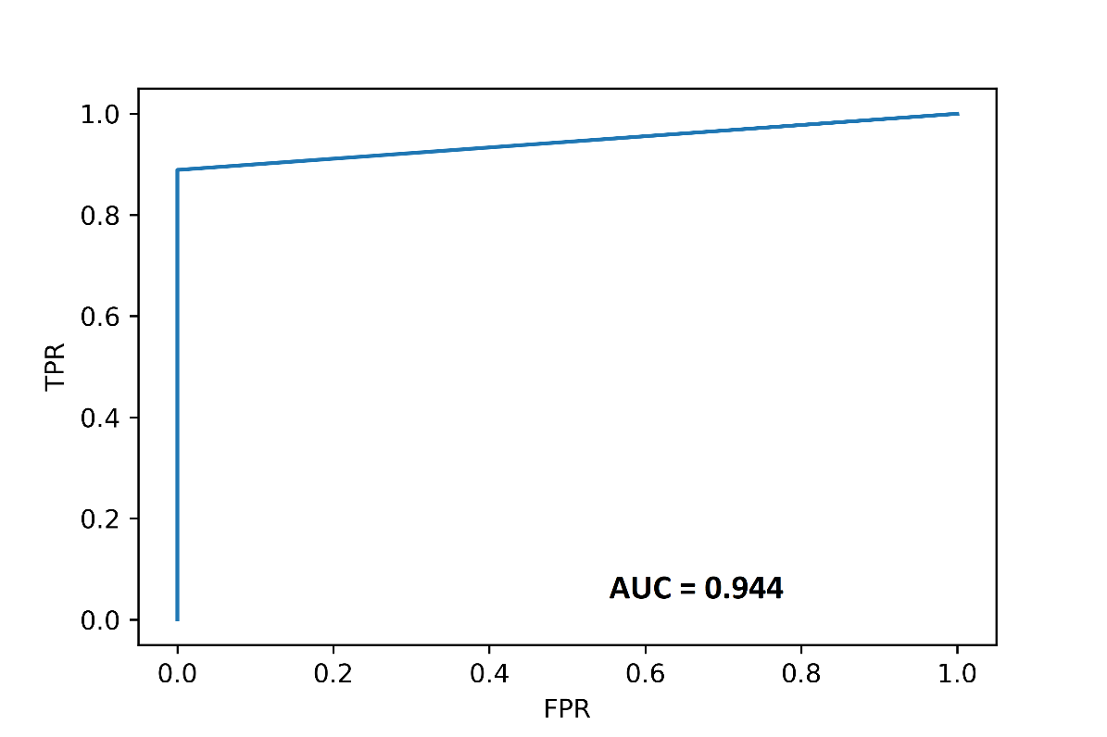
AREA UNDER ROC CURVE
It is measure of how well positive classes and negative classes are separated.
The Receiver Operating Characteristics (ROC) is plotted TPR (Sensitivity) verses FPR (1 - Specificity )

Slide 17
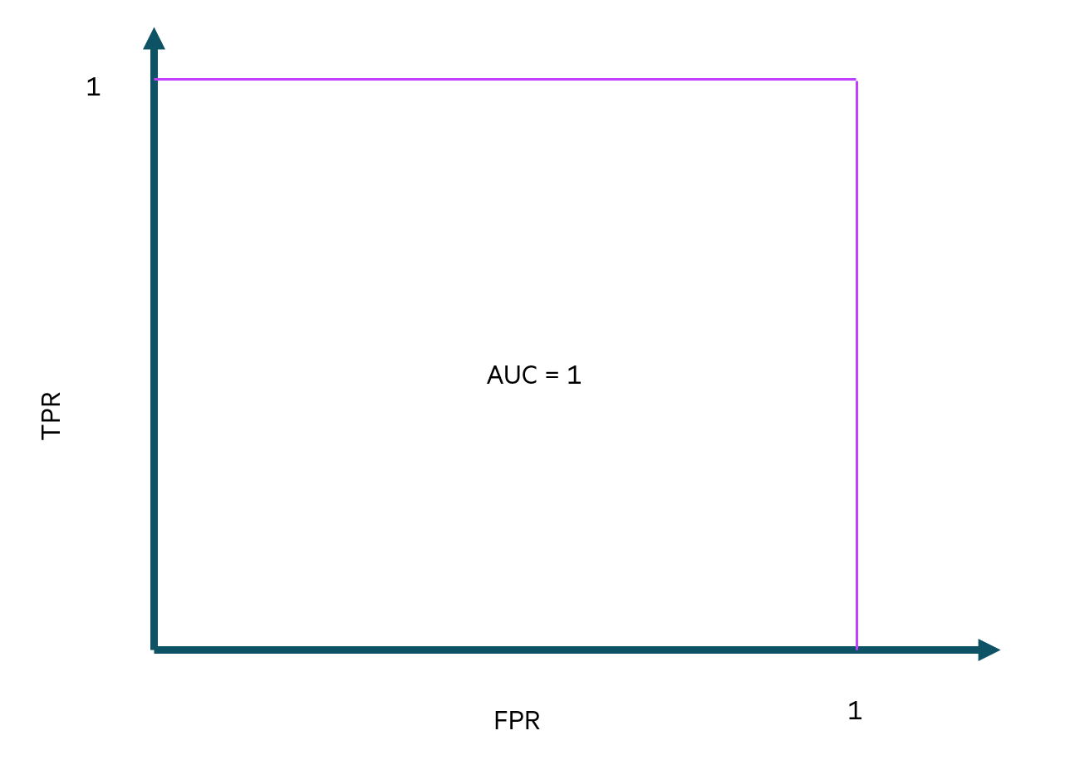
AREA UNDER ROC CURVE
If AUC = 1, then the classifier is capable of correctly separating all Positive and Negative class points.

Slide 18
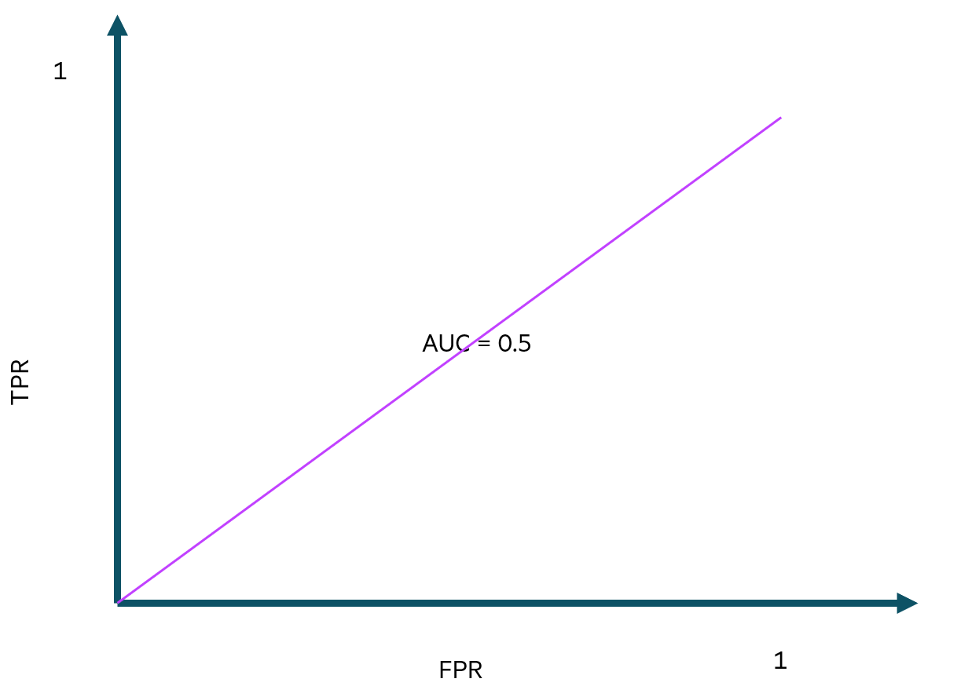
AREA UNDER ROC CURVE
If AUC = 0.5, either the classifier predicts a constant class or a random class for all the data points.

Slide 19
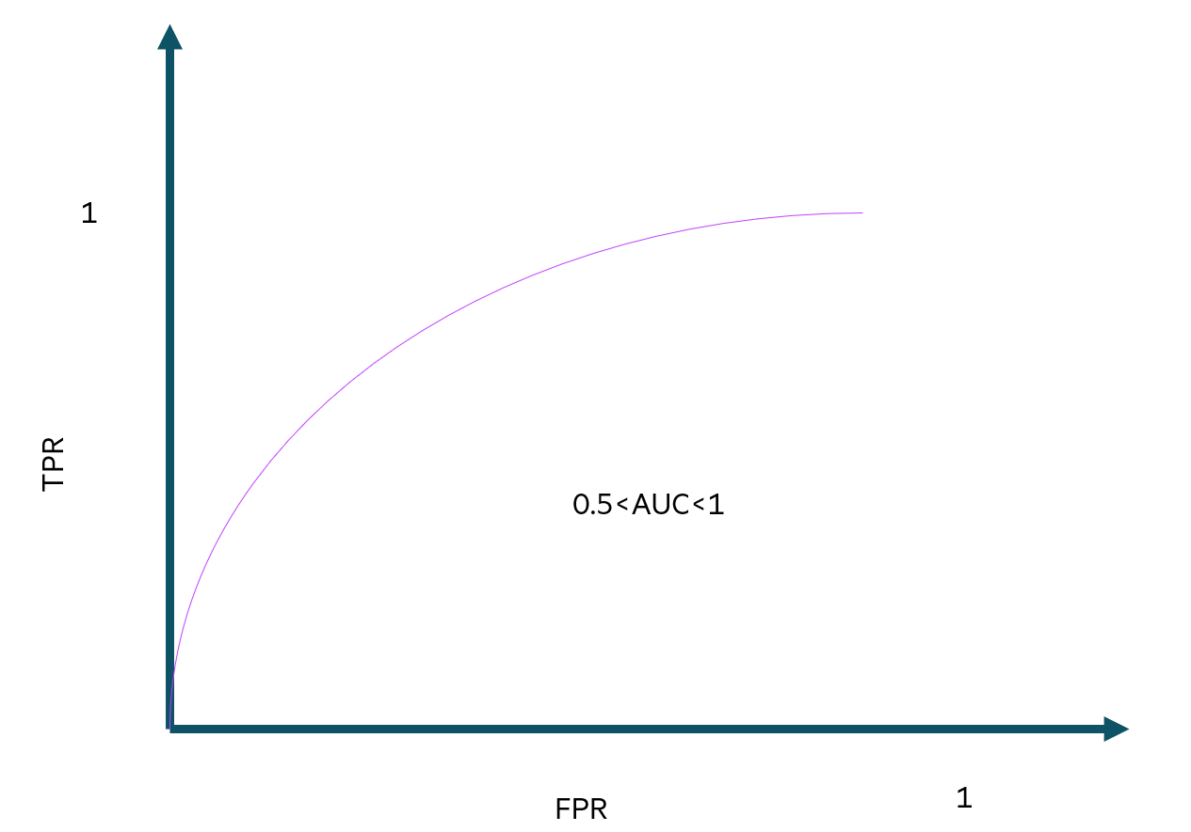
AREA UNDER ROC CURVE
In the case of 0.5<AUC<1, a high probability exists that the classifier will be able to identify positive and negative class values.

Slide 20
Lesson-2 Evaluation of REGRESSION Algorithms

Slide 21
Evaluation OF REGRESSION MODELS
For analysis of regression models, the metrics required will be different from that of the classification model.
Here the emphasis goes to error in the predicted value
Error is the difference between predicted value and actual value

Slide 22

Residuals
Residuals correspond to the distance vertically between a point and its regression line.
It is the difference between a predicted value and the observed value.
$$Residual =Y−\hat{Y}$$

Slide 23
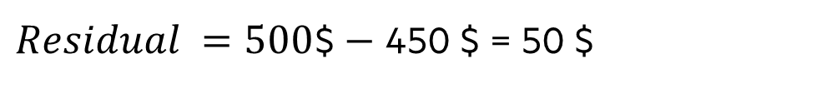
Residuals
Consider an example model for predicting the premium of the medical insurance based on the health features of an applicant.
If the predicted premium value is 450$ and actual value is 500$. Then the residual value will be,
$Residual =500\text{\$}−$ 450 $ = 50 $

Slide 24

MSE
Mean Square Error (MSE) is the squared difference between the actual value and predicted value
$$MSE= \frac{1}{N}\sum{{\left(Y− \hat{Y} \right)}^{2}}$$

Slide 25

MSE
For the example insurance premium prediction problem, if the summation of squared error is 1000 and 100 predictions are used, then MSE will be
$$MSE= \frac{\text{1000}}{100}=10$$

Slide 26

RMSE
Root Mean Squared Error (RMSE) is the square root of the mean squared error.
For instance, if our target and is the insurance premium in dollars, RMSE shows the error in dollars.
While MSE gives the error in dollars squared, which is more difficult to interpret.
$$RMSE=\sqrt{\frac{1}{N}\sum{{\left(Y− \hat{Y} \right)}^{2}}}$$

Slide 27

MAE
Mean Absolute Error (MAE) is defined as the absolute error between the actual and predicted values.
$$MAE= \frac{1}{N}\sum{\left|Y−\hat{Y}\right|}$$

Slide 28

MAE
If we have 100 predictions and summation of residuals of these 100 predictions is 250$ in our example regression problem.
Then MAE will be
$$MAE=\frac{250\$}{100}=2.5\$\text{.}$$

Slide 29

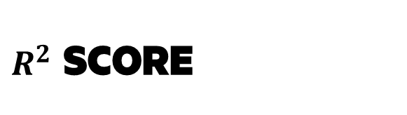

$R^{2}$ SCORE
R – Squared is the measure of how the regression line is better than the mean line.
$R^{2}$ Score indicates the square of the correlation (R) between the variables.
$R^{2}$ gives more interpretable values than R.
$$R^{2}Score = 1− \frac{Squared Sum Error of Regression Line}{Squared Sum Error of Mean Line}$$

Slide 30
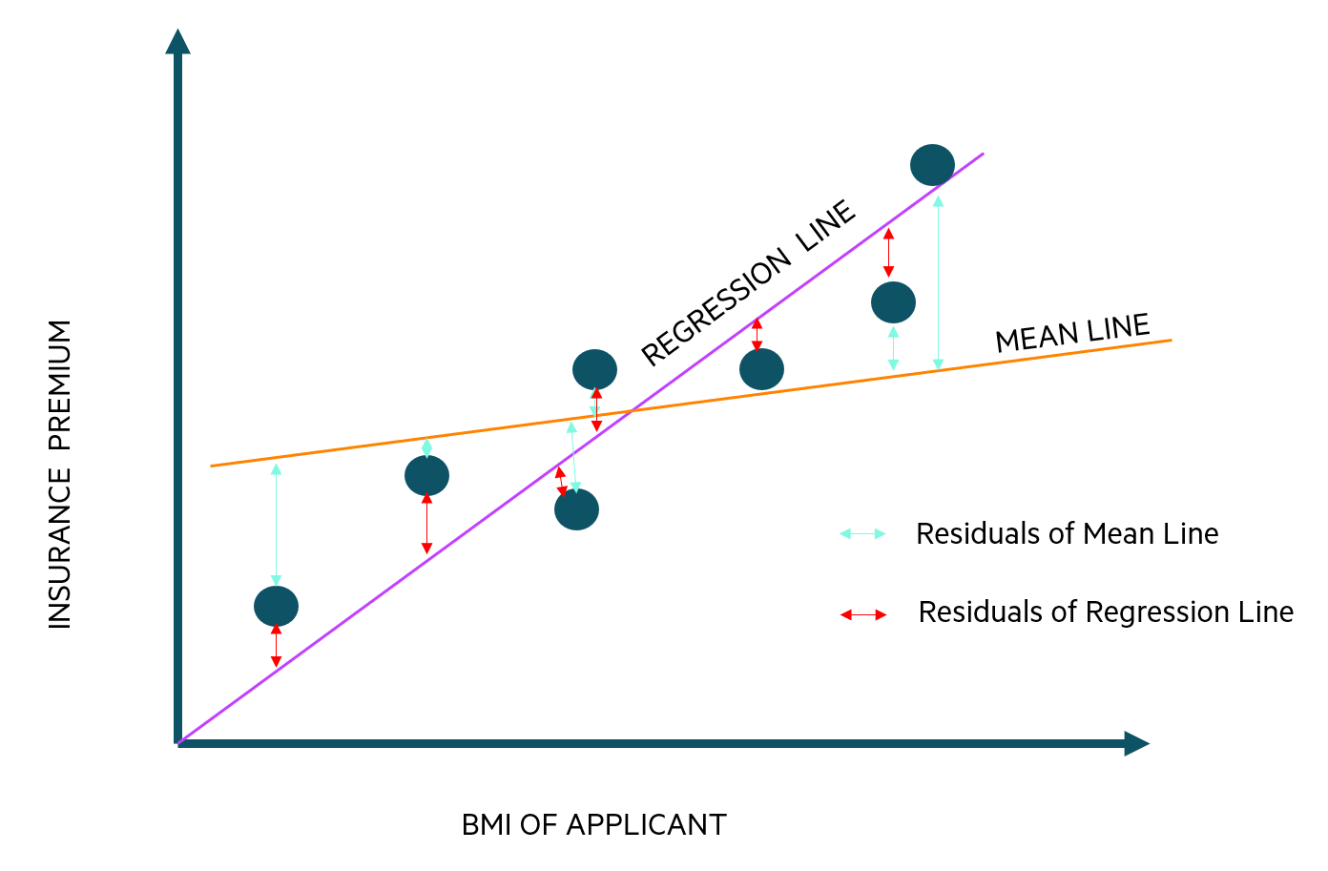
$R^{2}$ SCORE
The figure shows the relation between two variables, insurance premium and Body Mass Index (BMI), in our example regression problem.
The blue dots are the data points, orange line indicates the mean line and the purple line indicates the regression line.

Slide 31
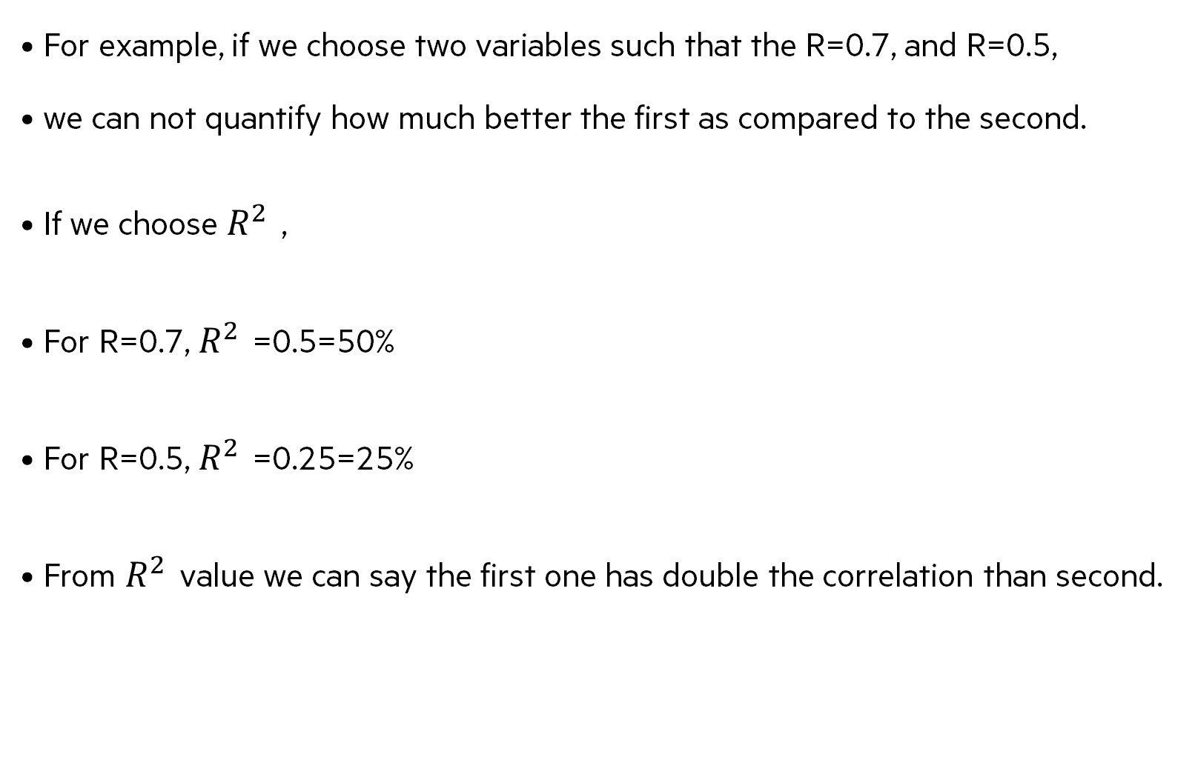
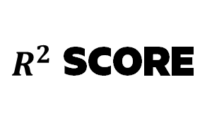
$R^{2}$ SCORE
For example, if we choose two variables such that the R=0.7, and R=0.5,
we can not quantify how much better the first as compared to the second.
If we choose $R^{2}$ ,
For R=0.7, $R^{2}$ =0.5=50%
For R=0.5, $R^{2}$ =0.25=25%
From $R^{2}$ value we can say the first one has double the correlation than second.

Slide 32
Lesson-3 Evaluation of CLUSTERING Algorithms

Slide 33
Evaluation OF CLUSTERING MODELS
In contrast to supervised machine learning, the clustering algorithm presents a slightly different challenge as it does not contain ground truth labels.

Slide 34
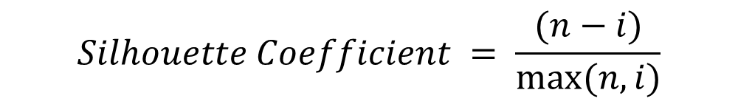
Silhouette Score
It is the measure of separateness between the clusters
It is a value between -1 and +1.
For mean intra cluster distance (i) and mean nearest cluster distance (n), the silhouette score is,
$$Silhouette Coefficient = \frac{(n−i)}{max⁡(n,i)}$$

Slide 35
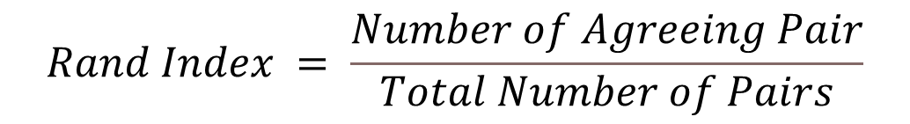
Rand Index
This is the measure of similarity for every pair in our model to each pair in optimal or ground truth cluster
The value is between 0 and 1, for a perfect fit the RI will be 1.
$$Rand Index = \frac{Number of Agreeing Pair}{Total Number of Pairs}$$

Slide 36

Adjusted Rand Index
It overcomes the unpredictability in the expected value of rand index between two random clusters.
$$Adjusted Rand Index = \frac{RI−Expected RI}{\max\left(RI\right)−Expected RI}$$

Slide 37
Davies-Bouldin Index
Davies-Bouldin Index measures the similarity between clusters based on the ratio of distances within and between clusters.
Lower the score the better the clustering performance.
Clusters that are farther apart and less dispersed will lead to a higher score.

Slide 38
Thank you

